Slide 1
Is there a correlation between the university score and the attributes of the university's Wikipedia page?
LIJIAXUE
ZHANG MENG
ZHANGYUZHUO
SANGHYUK SON
Notes:
We did the research under the theme of ‘Is there a correlation between the university score and the attributes of the university's Wikipedia page?’.

Slide 2
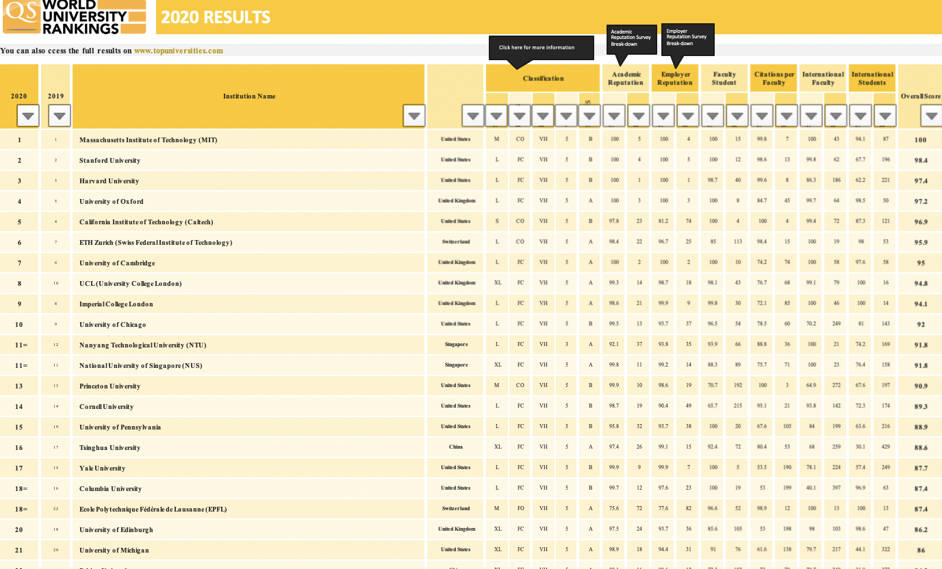

Meaning of ‘University Level’
Notes:
To begin the analysis, we need to define what is ‘university score’ and what is the ‘attributes of the university’s Wekipedia page’
There are various institutions that grade universities, and the institutions announced scores every year(such as ‘QS World University Rankings by Quacquarelli Symonds’, ‘THE Ranking by Times Higher Education magazine’, and ‘Academic Ranking of World Universities (ARWU) by Shanghai Jiao Tong University ’).
From all of these, we chose QS ranking to use in this analysis. This is because, first, according to Alexa data, they are the world's most-viewed global university rankings. Second, QS rankings provided neat data for dating analysts.
We use 2020 QS score of 1000 universities as our data.

Slide 3
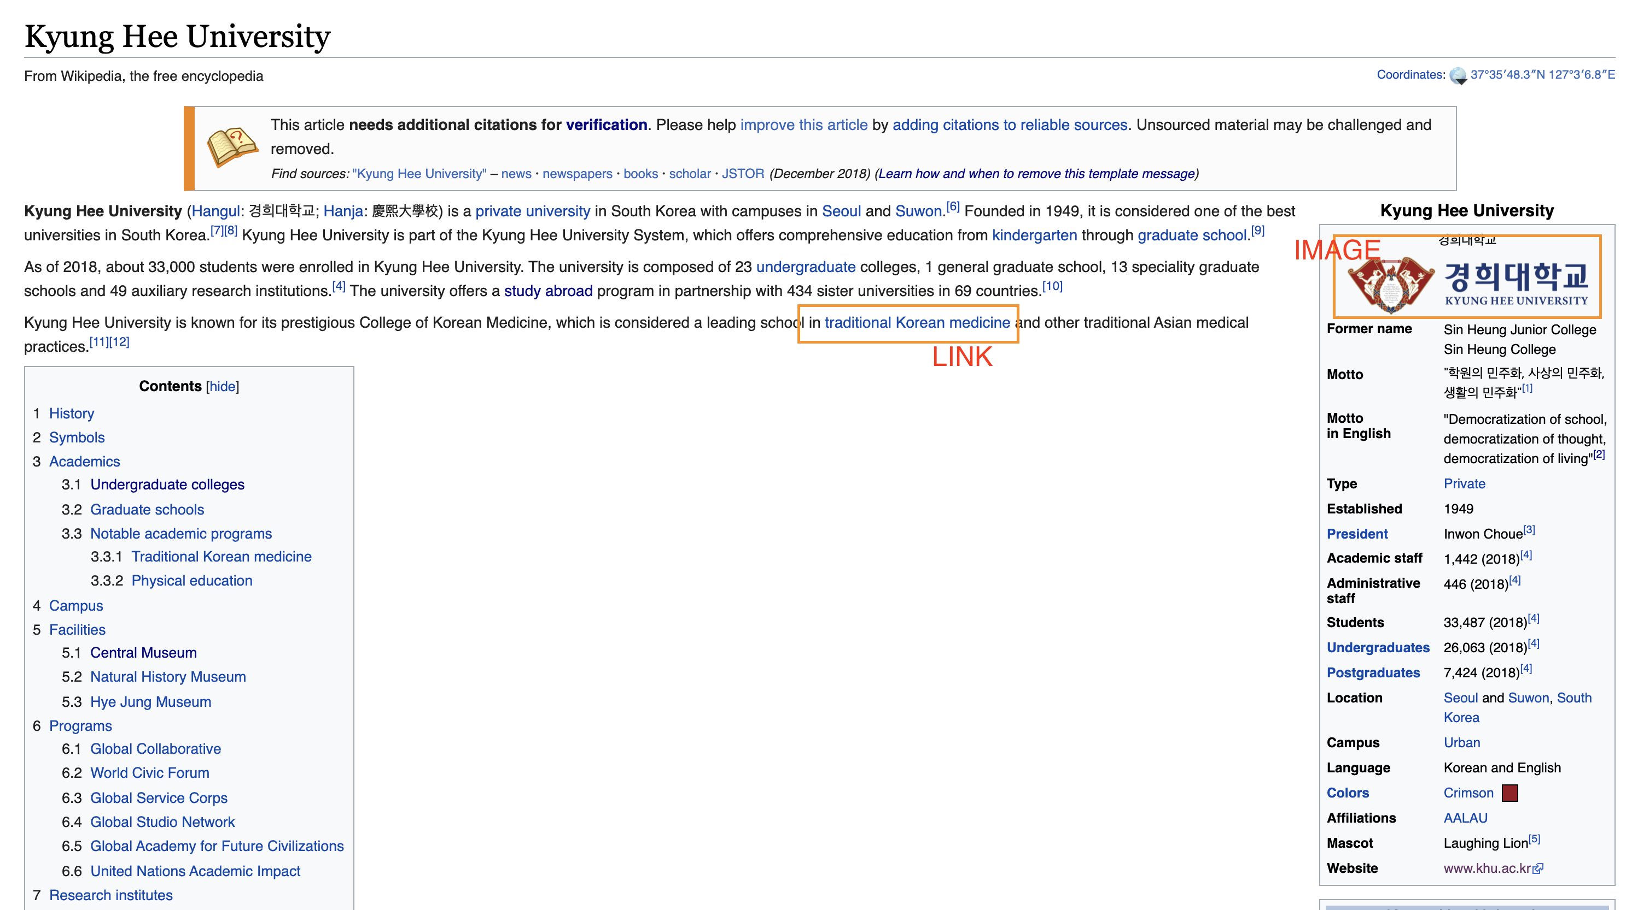

Meaning of ‘the attributes of the university's Wikipedia page’
Notes:
The attributes of the university's Wikipedia page means the ‘HTML’ features of the wiki pages, such as the total number letter of this document, the number of image, number of Header, the number of links et cetra.
As you can see,
these are the header 2, which is ordinarily used as sub-title of the document,
header 3, which is used as bold-face letter to emphasize a particular content,
link, with which which If you click this, you would go to other connected wiki page or another websites.
,and image.

Slide 4
Notation
H2 - the number of the header 2 of each wiki document
H3 - the number of the header 3 of each wiki document
img - the number of the images of each wiki document
internal_link - the Number of links connected to other Wikipedia documents. EX) ~/wiki/*
external_link – the Number of links connected to external sites other than Wikipedia. EX) http://www.*
total_link – internal_link + external_link
Overall - Overall Score of universities(by QS).
Notes:
In this analysis, we especially focus on 7 characteristics of the document.
‘The number of Header2, Header3, Image, Internal Link, External Link, Letters’.

Slide 5
Collect the Data
Process
Visualize & Analyze the Data
And More
Notes:
We've done the project in this order.
Collect the Data, Visualize and Analyze the Data, and more.

Slide 6

Randomly select the 50 universities from all universities in QS Score.
Collect The Data
Visit the wiki sites of those 50 universities and collect
all the information in the web-page.
Dig up the information mentioned in the preceding slide
Arrange it by chart, and give it to us.
Notes:
First of all, we had to collect the web data. To do that, we made web scraping machine. Here's how our machines work.
First, Randomly select the 50 universities from all universities in QS Score.
Second, Visit the wiki sites of those 50 universities and collect all the information in the web-page.
Third, Dig up the information mentioned in the preceding slide
Fourth, Arrange it in chart, and give it to us.

Slide 7
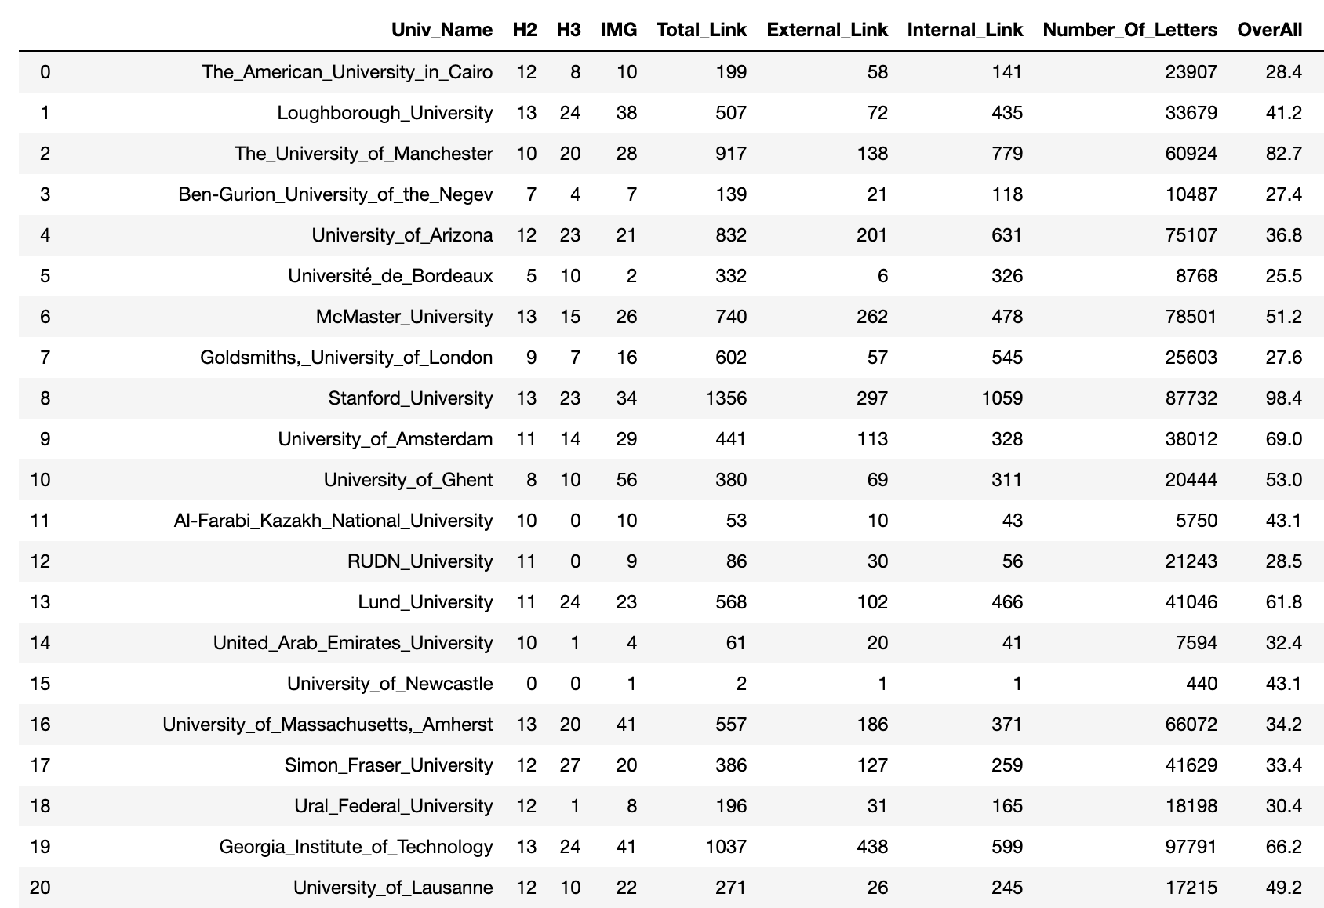
Collect The Data
Notes:
This is the chart it give us. There are only 20 rows visible, but this chart has a total of 50 rows in reality.

Slide 8
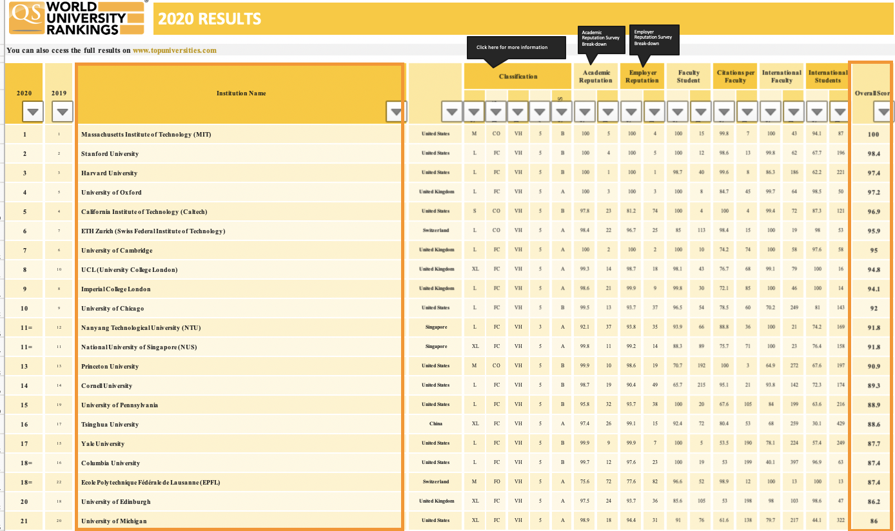
Collect The Data
Notes:
And then, we utilized open data provided by QS. This data has many scores and rankings of total 1000 universities. We used ‘Institution Name’ column to give to Crawling Machine, and ‘OverallScore’ column to analyze.

Slide 9
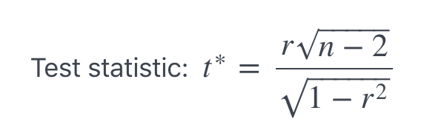
Hypothesis Testing
Null hypothesis H0: ρ = 0
The population correlation coefficient is not significantly different from zero.
There is not a significant linear relationship (correlation) between x and y in the population.
Alternate hypothesis: Ha: ρ ≠ 0
Alternate hypothesis Ha: The population correlation coefficient is significantly different from zero.
There is a significant linear relationship (correlation) between x and y in the population.
Notes:
Now with these data, we did a hypothesis testing of how each wiki attribute relates to an overall score. As you can see, we execute t-test hypothesis testing to see if there was a correlation coefficient.

Slide 10
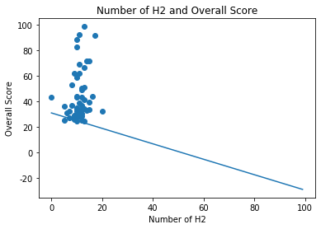
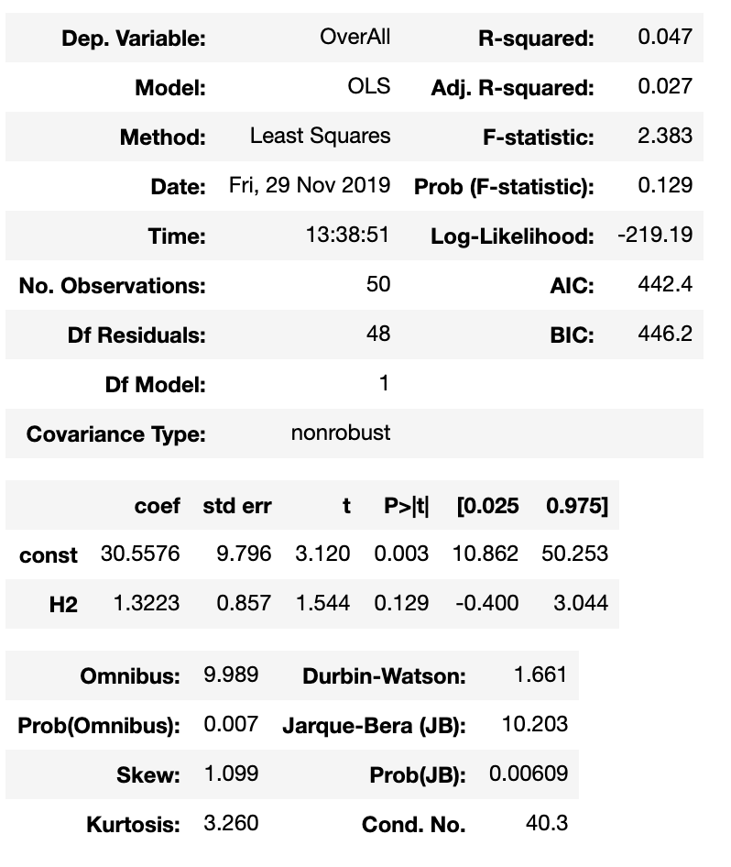
Visualize & Analyze – H2 & Overall Score
r = 0.217
Hypothesis Testing – Correlation Coefficient, T-test
H0: r=0 H1: r≠0
P-value : 0.129
Linear Regression
Notes:
From now on, Let's take a look at one by one whether the seven wiki attributes are correlated with the overall core. In the scatter plot graph, we draw the the 50 dots of the data, and the line is obtained through linear regression.
First of all, let’s see the H2 and overall score.
R value is calculated as 0.217, really low. And p-value is too big, so that we can think the correlation coefficient of these two variables are close to 0. Regression test also tells told me a similar story to us.

Slide 11
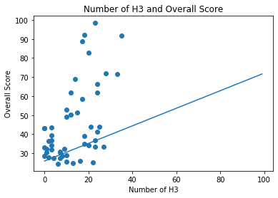
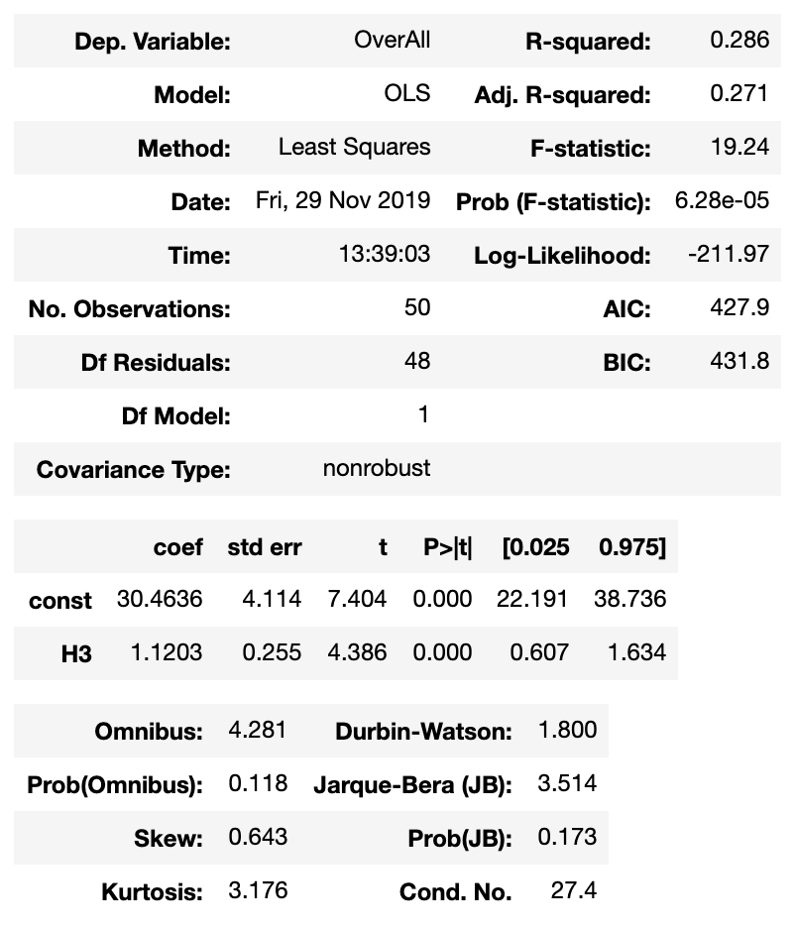
Visualize & Analyze – H3 & Overall Score
r = 0.535
Hypothesis Testing – Correlation Coefficient, T-test
H0: r=0 H1: r≠0
P-value : 0.00
Linear Regression
Notes:
Second, H3 and Overall Score.
R is 0.535, so that we can say that ‘these two variables have a moderate positive relationship’. And p-value is almost 0, so that we can say the correlation coefficient is significantly different from 0.

Slide 12
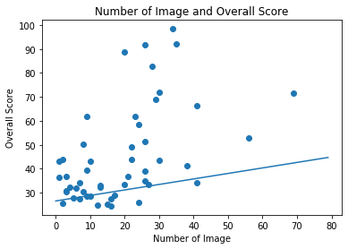

Visualize & Analyze – Image & Overall Score
r = 0.516
Hypothesis Testing – Correlation Coefficient, T-test
H0: r=0 H1: r≠0
P-value : 0.00
Linear Regression
Notes:
Third, image and overall score.
R is 0.516 and p-value is almost 0. The result is almost same with that of H3. Moderate positive relationship.

Slide 13
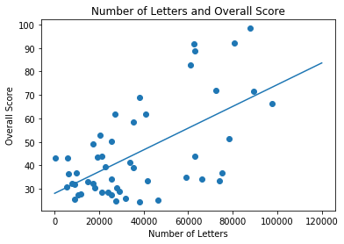
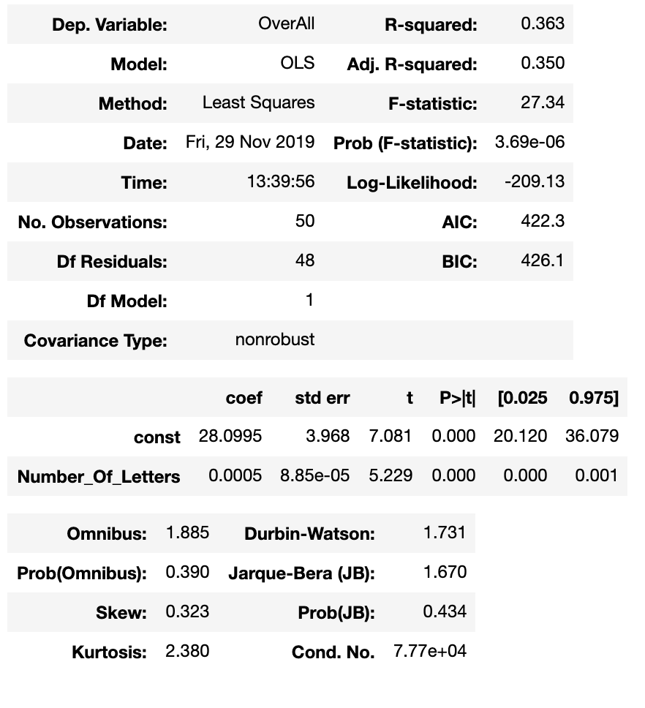
Visualize & Analyze – Number of Letters & Overall Score
r = 0.602
Hypothesis Testing – Correlation Coefficient, T-test
H0: r=0 H1: r≠0
P-value : 0.00
Linear Regression
Notes:
Fourth, the number of letters and Overall score.
R is 0.602, and p-value is almost 0, so that we can also get the same result with H3 and Image. moderate positive relationship

Slide 14
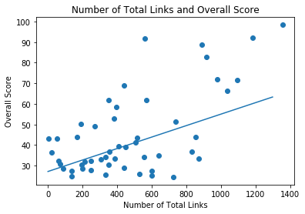
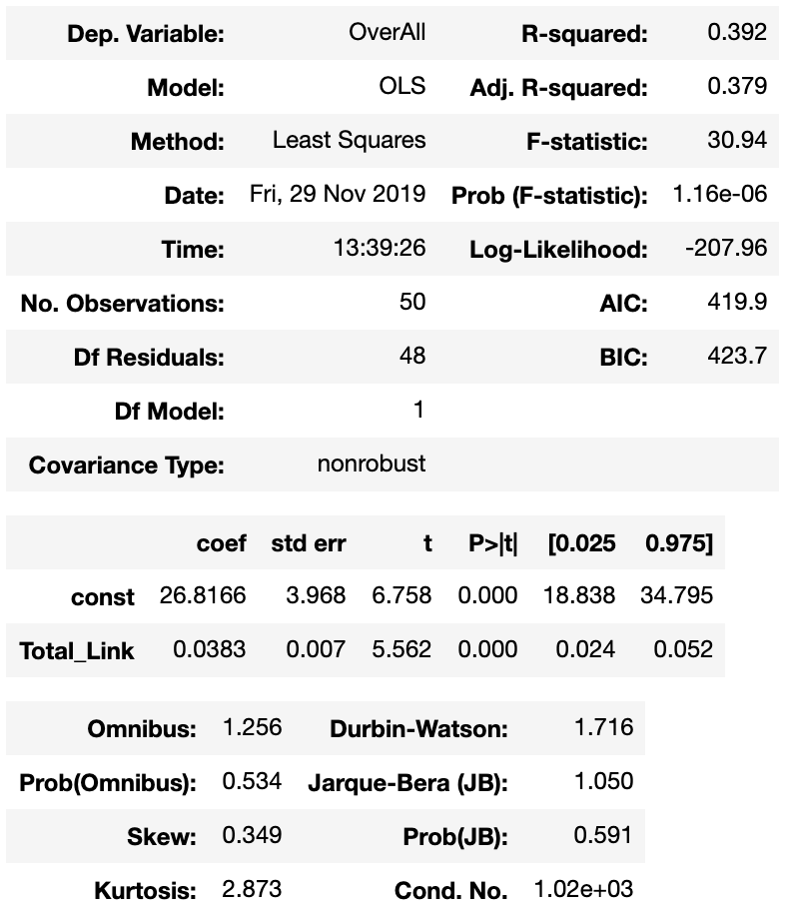
Visualize & Analyze – Total Links & Overall Score
R = 0.626
Hypothesis Testing – Correlation Coefficient, T-test
H0: r=0 H1: r≠0
P-value : 0.00
Linear Regression
Notes:
Next, number of total links and overall score.
R is 0.626 and p-value is almost 0, so that we can say that ‘these two variables have a moderate positive relationship’.

Slide 15
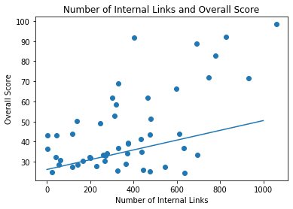
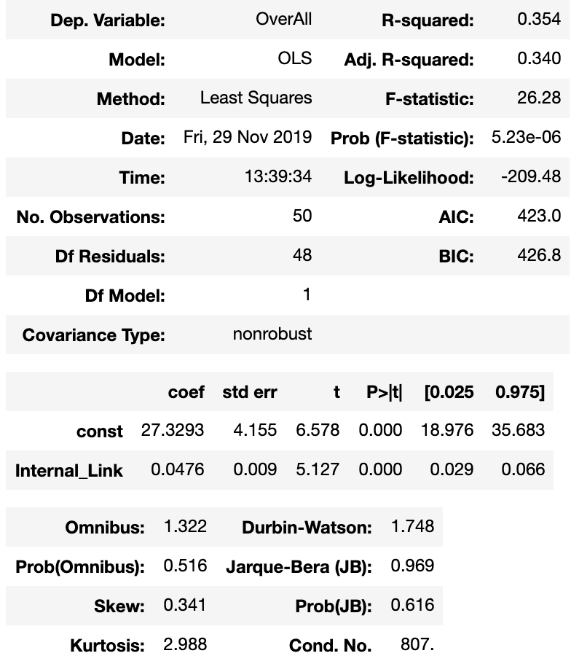
Visualize & Analyze – Internal Links & Overall Score
R = 0.595
Hypothesis Testing – Correlation Coefficient, T-test
H0: r=0 H1: r≠0
P-value : 0.00
Linear Regression
Notes:
Next, number of internal links and overall score.
R is 0.592, and p-value is almost 0. Same with the last slide.

Slide 16
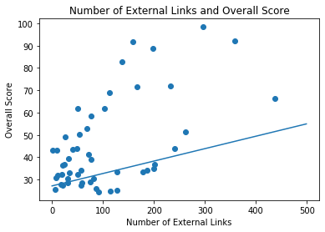
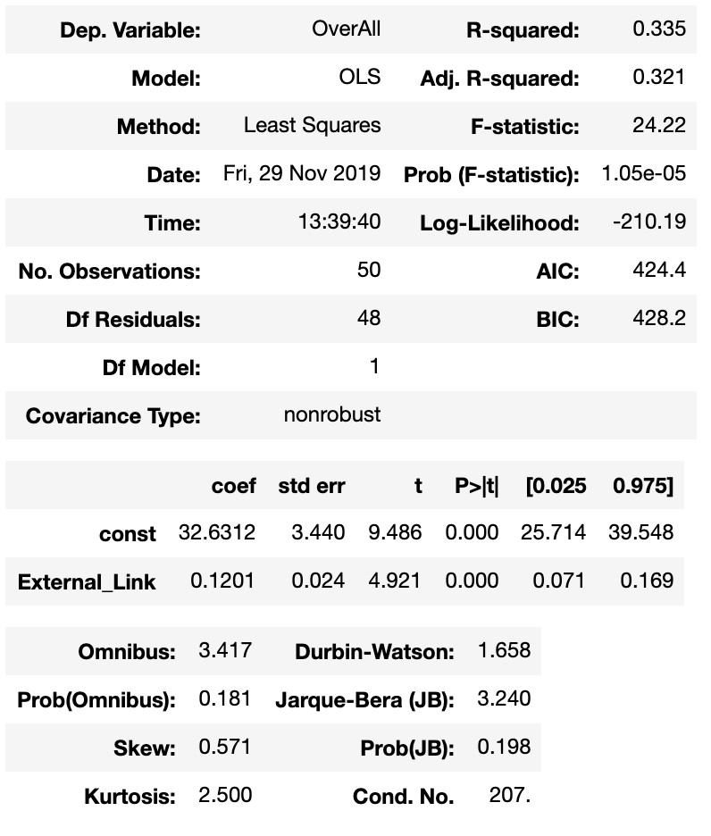
Visualize & Analyze – External Links & Overall Score
R = 0.579
Hypothesis Testing – Correlation Coefficient, T-test
H0: r=0 H1: r≠0
P-value : 0.00
Linear Regression
Notes:
Next, number of external links and overall score.
This result is also almost same with the previous result, which shows the correlation between internal links and overall score.

Slide 17
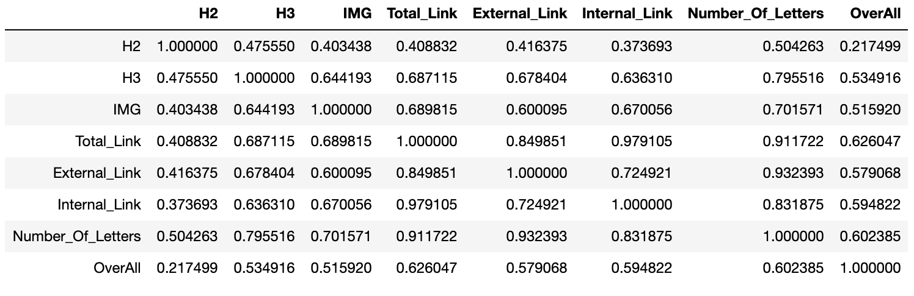
Visualize & Analyze
Notes:
This is the summary of correlation coefficient. The table shows correlation not only between each variable and overall score, but also between each 7 variable and one another. By seeing this, we can know that these 7 variables have big Multicollinearity with one another.

Slide 18
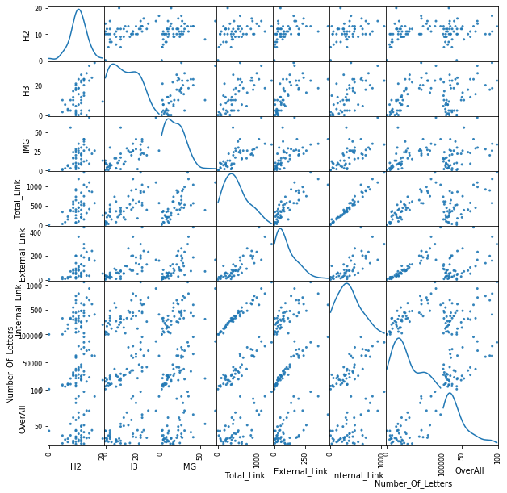
Visualize & Analyze
Notes:
When we see the graph, we can feel the multicollinearity of 7 variables much vividly.
So, we tried the multi variable regressions, but of course, we didn't get a good result because of multicollinearity problems.

Slide 19
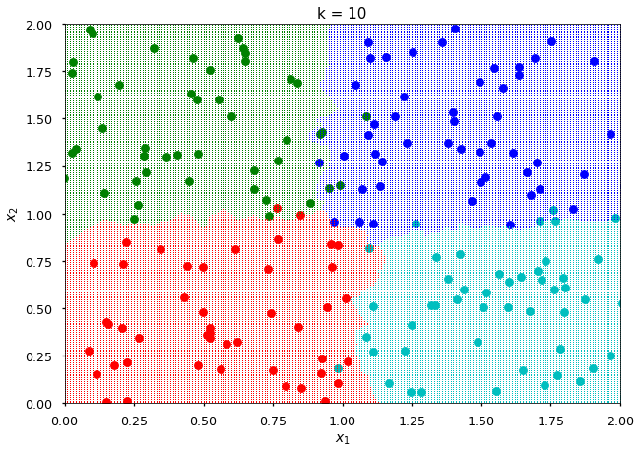
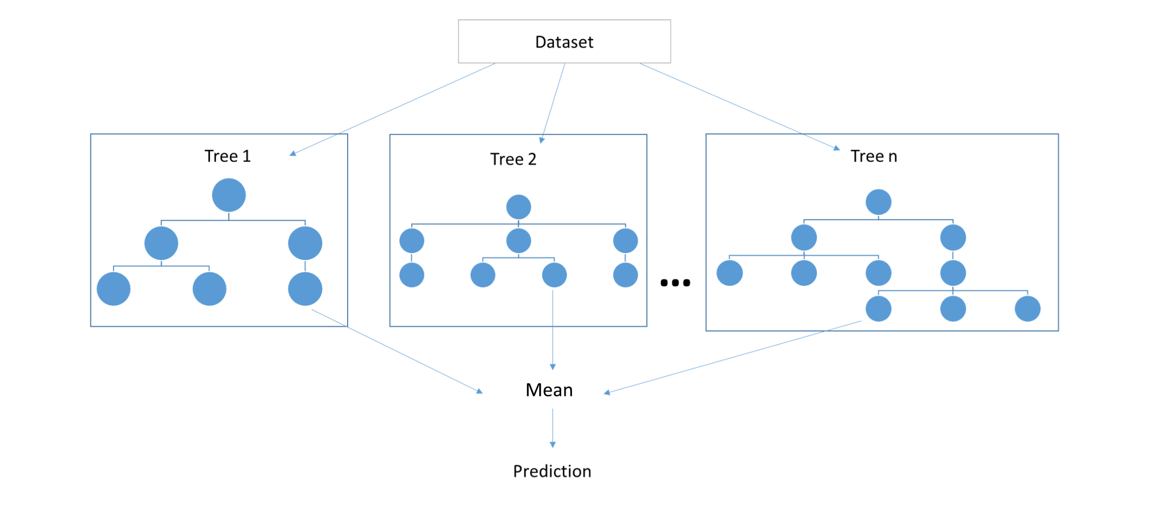
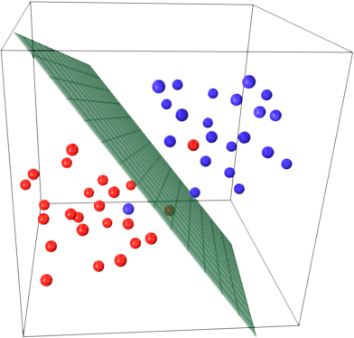
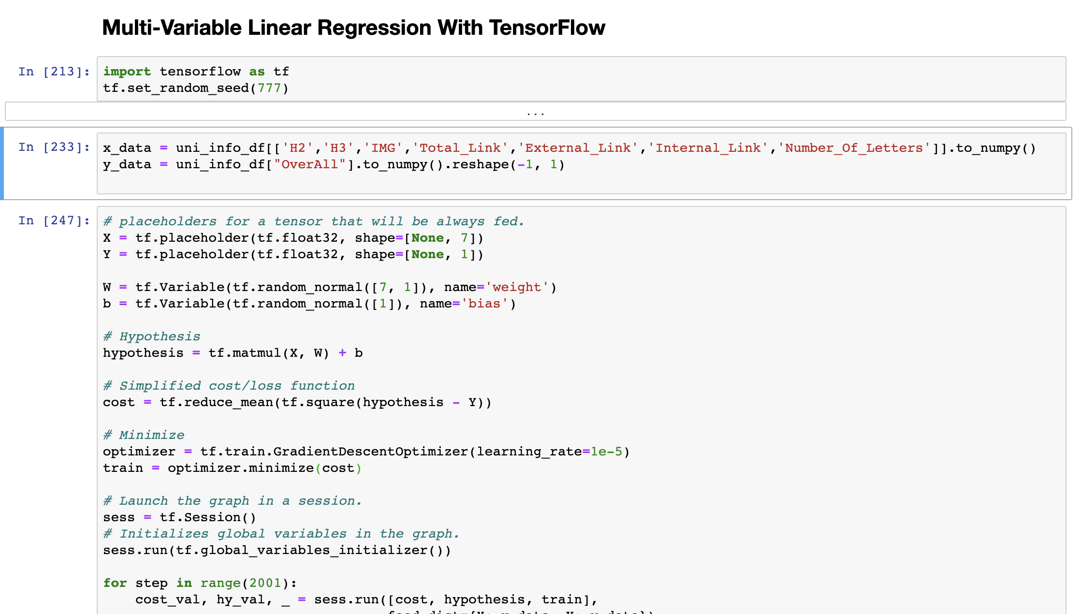
And More
Random Forest
KNN
SVM
Notes:
If you have noticed the previous ppt slides, you would find that the R-square values for the regression analyses we've been doing are very low. In fact, this could be a problem. However, when we solve a lot of real-world problems, it's very hard to see a high R-square values. So we're not just frustrated with this, but we're trying to find a better model with diverse algorithms. All process are in our code repository, we'll attach it to the last report if I get good results.

Slide 20
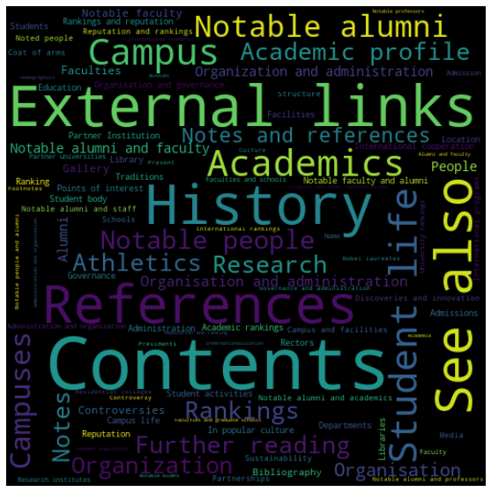
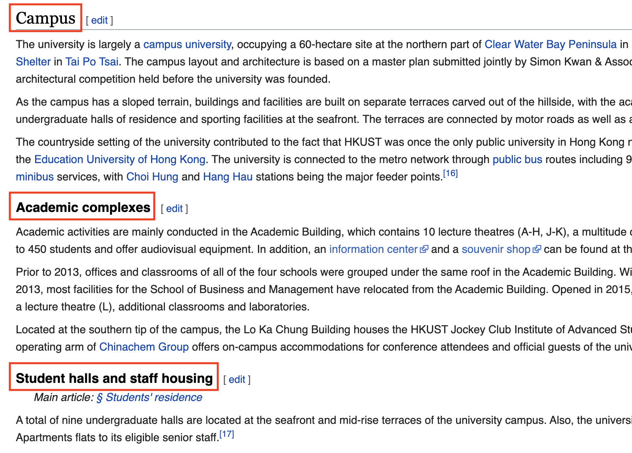
And More
Notes:
Also, even though it may not be relevant to this report, we also let our crawling machine to assemble sub-title(h2) from wiki document of 1000 schools on QS, and made the word cloud. In fact, since we can find some correlation between the level of the school and the Wikipedia document, I think it would be also nice to look at the Wiki documents of other world-class schools and try to decorate our school’s wiki document together.

Slide 21
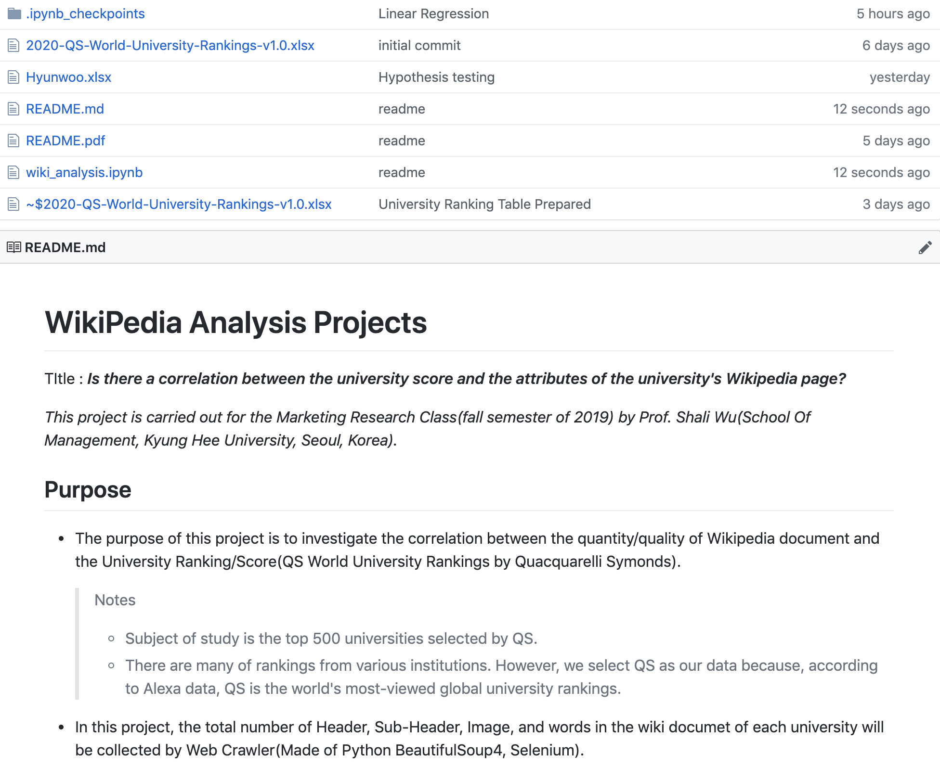

Libraries and Packages we use
Web Scraping : BeautifulSoup4, Scrapy, Selenium, AWS EC2 Linux
Automation : Linux Daemon
Browser Controller : Selenium Headless Chrome
Data Pre-Processing : Pandas, Numpy
Visualization : Matplotlib, Seaborn, WordCloud
Model Fitting & Hypothesis Testing: Stats, TensorFlow, Scikit Learn
Welcome to join us
Code Repository
https://github.com/saanghyuk/wiki_projects
Notes:
These are the libraries and packages we used to prepare this project. We upload all of the codes and graphs in the code repository, Github.

Slide 22
Thank you
Notes:
Thank you for listening.

